Slide 1

openQA
Fully automated testing
Next → how it works
  Installation and upgrade testing
  Daily regression testing
  Application & network testing
  benchmarking
Overview of test results along with screen shots and video
Notes:
openQA is a automated testing system which runs daily tests on the openSUSE development tree 'Factory'.

Slide 2
How does it work?
Next → Screenshots
Boot ISO in VM (KVM or Qemu)
Give pre-defined input
Take screenshots of process
Compare screen shots with reference
Show results in web interface
Notes:
It works by booting up a ISO image (which is automatically generated daily from the Open Build Service) in a Virtual Machine. It installs it, boots, starts some applications and does a few simple actions. It takes screenshots during that process. It will then compare the screenshots it got with what was expected and thus know the test results.

Slide 3
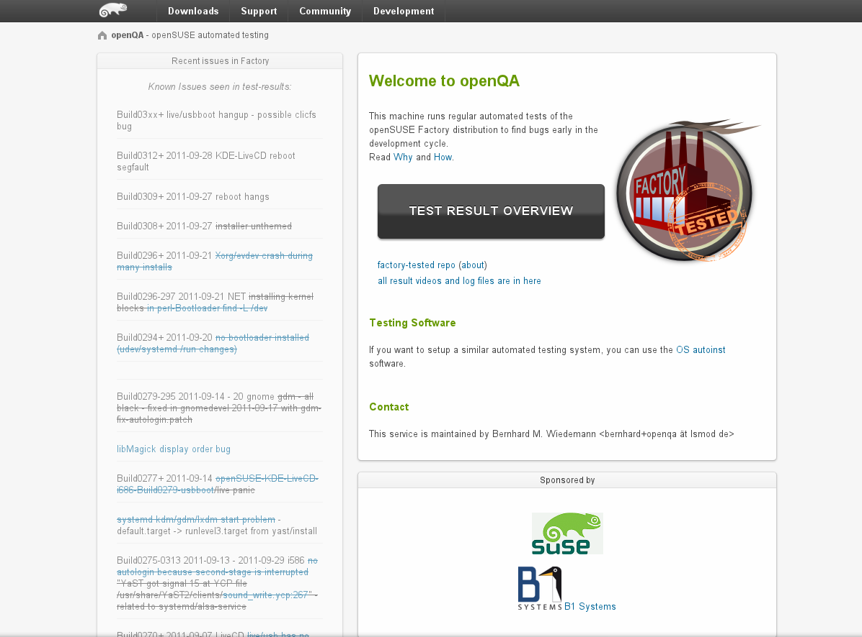
Welcome to the openQA web interface openQA automated testing framework
Notes:
This is the main interface of openqa.opensuse.org where you can check the test results.

Slide 4
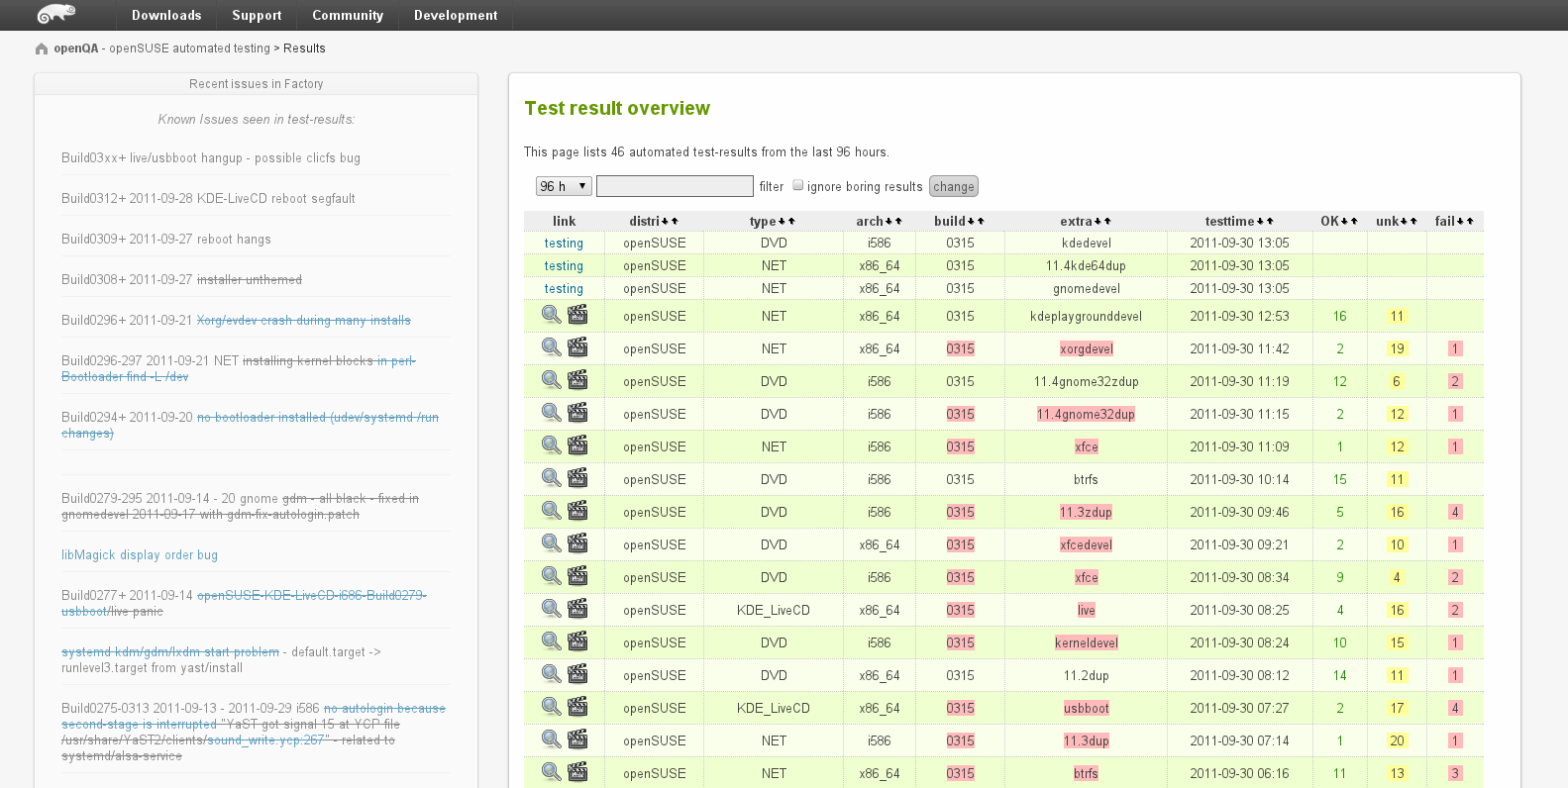
Overview of all tests ran on openSUSE Factory openQA automated testing framework
Notes:
Here is a list of tests which has run and the results.

Slide 5
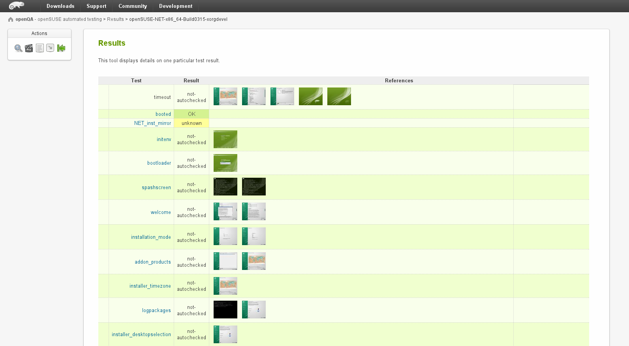
In-dept results of a test from openQA automated testing framework
Notes:
You can see the details of a test, and as you can see you can download and inspect the screenshots.

Slide 6
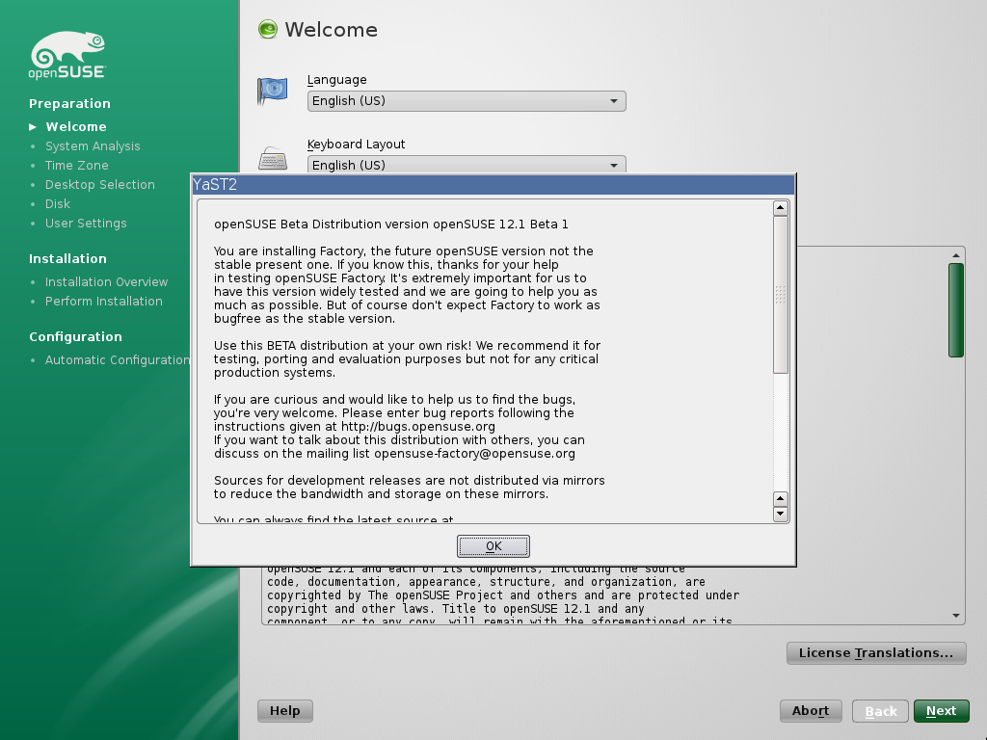
Screen shot as taken by the openQA automated testing framework
Notes:
Besides the screenshots openQA also offers video's of the whole process for download.

Slide 7
Notes:
To get openSUSE, go to openSUSE.org. You will find download links and more.
To build your own OS on top of openSUSE, go to susestudio.com – you can customize it with your packages, artwork and even files and scripts, then download it for an USB stick, hard drive or CD.
Of course you can look up an openSUSE ambassador like me and see if they have some DVD's of openSUSE for you!

Slide 8
Have a lot of fun!
Notes:
Thanks for listening!

